Slide 1


Accountability
2014!!
Tori Mitchell, ESC 17 Specialist
tmitchell@esc17.net
@esc17ace
Shauna Lane, ESC 17 Specialist
slane@esc17.net
@esc17counselor
Ty Duncan, ESC 17 Coordinator
tduncan@esc17.net
@instructionalle

Slide 2
2014 Accountability Timeline
June Entire 2014 Accountability Manual
Early June TEASE postings of comparison groups, graduation, dropouts, RHSP/DHP graduates
July Consolidated Accountability File
Late July? 2014 Accountability posted in TEASE
August 8 2014 Accountability posted publicly on TEA’s website
18

Slide 3
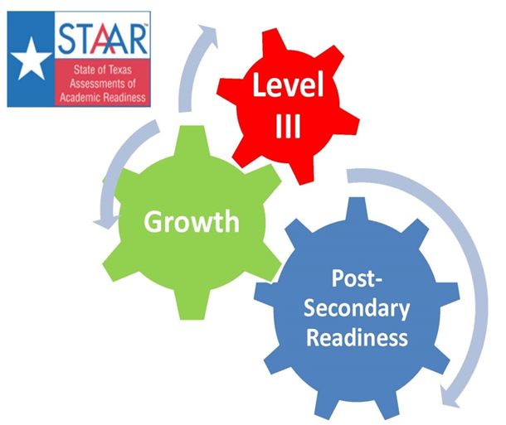
Learning is not attained by chance, it must be sought for with ardor and attended to with diligence. -Abigail Adams

Slide 4

Lead Learn Engage: Region 17 Leadership Conference August 5 and 6, 2014
http://escite2.esc17.net/default.aspx?name=wmsworkshop&w=14627

Slide 5

This Presentation was created based on information posted on the Texas Education Agency’s website at http://ritter.tea.state.tx.us/perfreport/account/2014/index.html

Slide 6
Performance Index Framework
To receive a
Met Standard rating, all campuses and districts must meet the performance targets for all four indexes for which they have performance data in 2014.
Student Achievement
Index I
Postsecondary Readiness
Index 4
Accountability System
Student Progress
Index 2
Closing Performance Gaps
Index 3

Slide 7
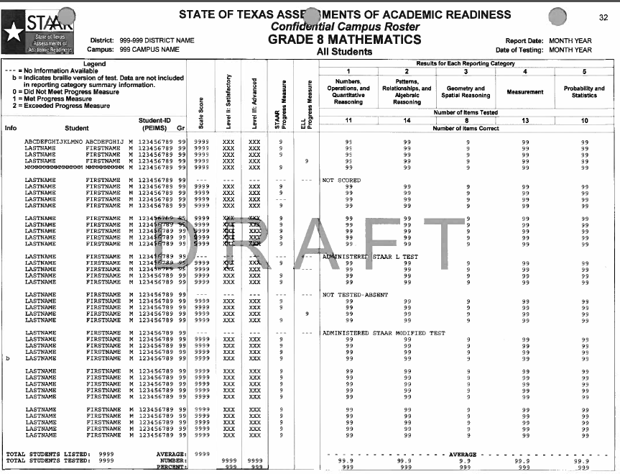
STAAR Progress Listed
-- Not available; 0 did not meet; 1 met; 2 exceeded
ELL Progress Measure will have values when it is applicable and can be calculated and STAAR Progress Measure will be blank

Slide 8
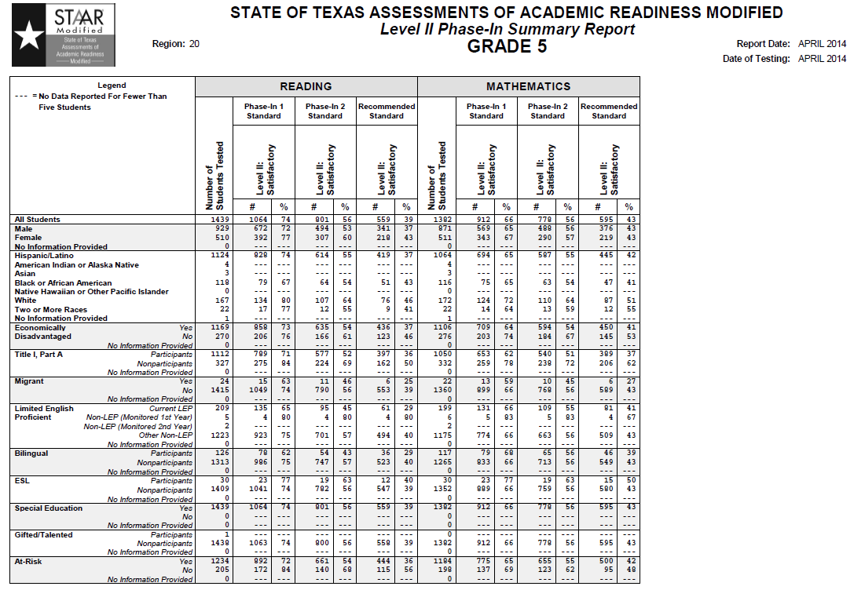

Slide 9

Pass/Fail Culture

Slide 10
Subject |  | Phase 1 | Phase 2 | Final | Level III
Reading | Grade 3 | 53% | 65% | 75% | 88%
 | Grade 4 | 52% | 66% | 77% | 86%
 | Grade 5 | 54% | 65% | 76% | 87%
 | Grade 6 | 52% | 65% | 75% | 88%
 | Grade 7 | 52% | 64% | 74% | 84%
 | Grade 8 | 50% | 63% | 75% | 85%
 | English I | 53% | 60% | 63% | 85%
 | English II | 54% | 59% | 63% | 85%
Math | Grade 3 | 59% | 72% | 83% | 91%
 | Grade 4 | 60% | 71% | 81% | 90%
 | Grade 5 | 54% | 66% | 78% | 88%
 | Grade 6 | 42% | 58% | 71% | 87%
 | Grade 7 | 44% | 56% | 69% | 85%
 | Grade 8 | 39% | 52% | 64% | 88%
 | Algebra 1 | 37% | 50% | 61% | 83%
Science | Grade 5 | 59% | 70% | 80% | 91%
 | Grade 8 | 56% | 65% | 74% | 78%
 | Biology | 37% | 51% | 61% | 83%
Social Studies | Grade 8 | 50% | 62% | 73% | 83%
 | US History | 41% | 53% | 65% | 81%
Writing | Grade 4 | 52% | 61% | 68% | 84%
 | Grade 7 | 54% | 63% | 71% | 85%

Slide 11
Subject |  | Phase 1 | Phase 2 | Final | Level III
Reading | Grade 3 | 53% | 65% | 75% | 88%
 | Grade 4 | 52% | 66% | 77% | 86%
 | Grade 5 | 54% | 65% | 76% | 87%
 | Grade 6 | 52% | 65% | 75% | 88%
 | Grade 7 | 52% | 64% | 74% | 84%
 | Grade 8 | 50% | 63% | 75% | 85%
 | English I | 53% | 60% | 63% | 85%
 | English II | 54% | 59% | 63% | 85%
Math | Grade 3 | 59% | 72% | 83% | 91%
 | Grade 4 | 60% | 71% | 81% | 90%
 | Grade 5 | 54% | 66% | 78% | 88%
 | Grade 6 | 42% | 58% | 71% | 87%
 | Grade 7 | 44% | 56% | 69% | 85%
 | Grade 8 | 39% | 52% | 64% | 88%
 | Algebra 1 | 37% | 50% | 61% | 83%
Science | Grade 5 | 59% | 70% | 80% | 91%
 | Grade 8 | 56% | 65% | 74% | 78%
 | Biology | 37% | 51% | 61% | 83%
Social Studies | Grade 8 | 50% | 62% | 73% | 83%
 | US History | 41% | 53% | 65% | 81%
Writing | Grade 4 | 52% | 61% | 68% | 84%
 | Grade 7 | 54% | 63% | 71% | 85%
Index 1 2014
Index 3 2014
Index 1 2015
Index 3 2015
Index 4 2014
Index 4 2015
Index 3 2014
Index 3 2015
Notes:
59

Slide 12
6th Grade Math
 |  | Phase-in 1 Standard | Phase-in 2 Standard | Final Standard |  | Phase-in 1 Standard | Phase-in 2 Standard | Final Standard
 |  | Level II Satisfactory | Level II Satisfactory | Level II: Satisfactory | Level III: Advanced | Level II Satisfactory | Level II Satisfactory | Level II: Satisfactory | Level III: Advanced
Category | Group | 2013 | 2013 | 2013 | 2013 | 2014 | 2014 | 2014 | 2014
All Students | State | 74 | 53 | 36 | 16 | 79 | 58 | 39 | 17
 | Region 17 | 67 | 46 | 30 | 12 | 74 | 51 | 32 | 14
Hispanic | State | 69 | 46 | 28 | 11 | 74 | 51 | 31 | 12
 | Region 17 | 60 | 36 | 20 | 6 | 67 | 40 | 23 | 7
African Am | State | 61 | 37 | 22 | 8 | 66 | 41 | 24 | 8
 | Region 17 | 49 | 28 | 14 | 4 | 48 | 24 | 12 | 3
White | State | 85 | 68 | 50 | 24 | 88 | 72 | 53 | 26
 | Region 17 | 83 | 66 | 48 | 22 | 88 | 71 | 50 | 24
Econ Disad | State | 66 | 42 | 25 | 9 | 72 | 47 | 28 | 10
Free Meals | Region 17 | 58 | 34 | 19 | 6 | 65 | 38 | 20 | 7
Current LEP* | State | 52 | 28 | 14 | 4 | 62 | 35 | 17 | 5
 | Region 17 | 52 | 26 | 13 | 3 | 54 | 24 | 6 | 2
Special Ed* | State | 38 | 20 | 11 | 4 | 47 | 24 | 13 | 5
 | Region 17 | 26 | 8 | 3 | 1 | 46 | 20 | 10 | 4

Slide 13
 | April 2014 STAAR Science, Grade 5
 |  | All SEs
 |  | 3.5(C) [S] | 3.6(B) [S] | 3.8(D) [S] | 3.9(A) [S] | 4.7(A) [S] | 5.1(A) [P] | 5.2(A) [P] | 5.2(B) [P]
 | Region 17 | 78.07% | 76.78% | 67.95% | 46.92% | 57.19% | 59.81% | 46.13% | 56.08%
Percent Score |  | 5.2(C) [P] | 5.2(D) [P] | 5.2(F) [P] | 5.3(C) [P] | 5.4(A) [P] | 5.5(A) [R] | 5.5(B) [S] | 5.5(C) [S]
 | Region 17 | 64.65% | 70.84% | 74.86% | 78.14% | 62.57% | 66.01% | 84.79% | 56.08%
68.25%
Level II Met |  | 5.5(D) [S] | 5.6(A) [R] | 5.6(B) [R] | 5.6(C) [R] | 5.6(D) [S] | 5.7(A) [R] | 5.7(B) [R] | 5.7(C) [R]
 | Region 17 | 51.16% | 70.91% | 76.12% | 66.25% | 62.17% | 61.52% | 56.62% | 74.61%
72.77%
Level III Advanced |  | 5.8(A) [S] | 5.8(B) [S] | 5.8(C) [R] | 5.9(A) [R] | 5.9(B) [R] | 5.9(C) [S] | 5.9(D) [S] | 5.10(A) [R]
 | Region 17 | 71.63% | 62.93% | 73.07% | 65.06% | 66.95% | 77.22% | 77.77% | 66.91%
9.25%
 |  | 5.10(B) [R] | 5.10(C) [S] |  |  | KEY
 | Region 17 | 80.44% | 76.16% |  |  |  | Matter/Energy
 |  |  |  |  |  |  | Force/Motion
 |  |  |  |  |  |  | Earth/Space
 |  |  |  |  |  |  | Organisms/Environments
 |  |  |  |  |  |  | Process Skill
 |  |  |  |  |  |  | Readiness Standard
 |  |  |  |  |  |  | Supporting Standard
 |  |  |  |  |  |  | Region 17 Percentages
Thank to Michelle Sedberry for sharing!
msedberry@esc17.net

Slide 14
Index 1: Student Achievement
2014 Target: non AEA 55 / AEA 30
Index 1: Student Achievement provides an overview of student performance based on satisfactory student achievement across all subjects for all students on BOTH general and alternative assessments.
Combined over All Subjects: Reading, Mathematics, Writing, Science, and Social Studies.
Student Group: All Students.
  no minimum size requirement and no ethnicity breakdown
Performance Standards: Phase-in 1 Level II (Satisfactory)
End of Course:
  July 2013: English I and II Reading Algebra 1, Biology, and US History
  Fall 2013: English I and II, Algebra 1, Biology and US History
  Spring 2014: English I and II Combined, Algebra 1, Biology and US History

Slide 15
Index 1: Student Achievement
2014 Target: non AEA 55 / AEA 30
Index 1: Student Achievement provides an overview of student performance based on satisfactory student achievement across all subjects for all students on BOTH general and alternative assessments.
English Language Learners (ELL) Included:
  English STAAR Two – Four Years in U.S. Schools* included using ELL Progress Measure
  English STAAR Five plus Years in U.S. Schools* included using Phase-in 1 Level II
  Spanish STAAR Two plus Years in U.S. Schools* included using Phase-in 1 Level II
  STAAR L included using ELL Progress Measure
English Language Learners (ELL) Exclusions:
English and Spanish STAAR English Language Learners (ELL) One year in U.S. Schools* excluded
*English Language Learners (ELL) Years in U.S. Schools as reported on 2014 TELPAS

Slide 16
Index 1: Student Achievement
2014 Target: non AEA 55 / AEA 30
Index 1: Construction
Since Index 1 has only one indicator, the Total Index Points and Index Score are the same: Index Score = Total Index Points. Total Index Points is the percentage
of assessments that meet the Phase-in 1 Level II Standard.
Each percent of students meeting the Phase-in 1 Level II performance standard contributes one point to the index. Index scores range from 0 to 100 for all campuses and districts.
Example: 2013 Index 1
 | Reading |  | Mathematics |  | Writing |  | Science |  | Social Studies |  | Total | % Met Phase-in 1 Level II | Index Points
Students Met or Exceeded Phase-in 1 Level II | 50 | + | 38 | + | 19 | + | 10 | + | 19 | = | 136 | 45% | 45
Students Tested | 100 | + | 100 | + | 42 | + | 40 | + | 23 | = | 305
Index 1 Score |  |  |  |  |  |  |  |  |  |  |  |  | 45

Slide 17
Index 1: Student Achievement
2014 Target: non AEA 55 / AEA 30
Index 1: 2013 vs. 2014 Comparison
2013
Combined over All Subjects: Reading, Mathematics, Writing, Science, and Social Studies.
Student Groups: All Students.
Performance Standards: Phase-in 1 Level II (Satisfactory).
STAAR End-of-Course (EOC) Assessments (15 total):
  English l – Reading; English ll – Reading; English lll – Reading
  English l – Writing; English ll – Writing; English lll – Writing
  Algebra l; Geometry; Algebra ll
  Biology; Chemistry; Physics
World Geography; World History; US History
English Language Learners (English and Spanish tests):
  Students in US schools Year 1 - Year 3 excluded
  Students in US schools Year 4 and beyond included
2014
Combined over All Subjects: Reading, Mathematics, Writing, Science, and Social Studies.
Student Groups: All Students.
Performance Standards: Phase-in 1 Level II (Satisfactory).
English Language Learners (English and Spanish tests):
Students in US schools Year 1 excluded
STAAR EOC Assessments (5 total):
English l (combined tests); English ll (combined tests) beginning in spring 2014
Algebra l
Biology
US History
Students in US schools Year 2 and beyond included
ELL Progress Measure included for those tested in English
Shaded areas are new for 2014
Texas Education Agency | Office of Assessment and Accountability | Division of Performance Reporting

Slide 18
Index One Accountability Tool
Index 1 - Student Achievement
Tests included: STAAR (Eng & Span), STAAR-M, STAAR-Alt, STAAR-L, & **ELL Progress (**See last tab on how to include ELLs for Index 1)
Junior High Campus | Reading |  | Writing |  | Mathematics |  | Science |  | Soc Studies |  | Total | % Met Level II
Students Met Phase-in Level II | 423 | + | 92 | + | 429 | + | 113 | + | 108 | = | 1165 | 88% | 88
# Students Tested | 477 | + | 108 | + | 477 | + | 133 | + | 133 | = | 1328
Index Score |  |  |  |  |  |  |  |  |  |  |  |  | 88

Slide 19
Index 2: Student Progress
2014 Target: 5th percentile based on campus type, district 5th percentile across all campus types
Index 2: Student Progress focuses on actual student growth independent of overall achievement levels for each race/ethnicity student group, students with disabilities, and English language learners.
By Subject Area: Reading, Mathematics, and Writing (for available grades).
Points based on weighted performance:
  One point given for each percentage of tests at the Met progress level.
  Two points given for each percentage of tests at the Exceeded progress level.
Additional progress measures in 2014: STAAR-M, STAAR-Alt, and ELL.
Additional progress measures in 2014: STAAR-M, STAAR-Alt, and English Language Learners (ELL).
Shaded areas are new for 2014

Slide 20
Index 2: Student Progress
2014 Target: 5th percentile based on campus type, district 5th percentile across all campus types
  Progress Measures by Subject Area and School Type
2013
Elementary School Middle School High School
READING
Gr. 4 Reading Gr. 6 Reading English l Reading
Gr. 5 Reading Gr. 7 Reading English ll Reading
- Gr. 8 Reading -
- English l Reading -
MATHEMATICS
Gr. 4 Mathematics Gr. 6 Mathematics Algebra l
Gr. 5 Mathematics Gr. 7 Mathematics -
- Gr. 8 Mathematics -
- Algebra l -
WRITING
- - English ll Writing
2014
Elementary School Middle School High School
READING
Gr. 4 Reading Gr. 6 Reading -
Gr. 5 Reading Gr. 7 Reading -
- Gr. 8 Reading -
- - -
MATHEMATICS
Gr. 4 Mathematics Gr. 6 Mathematics Algebra l
Gr. 5 Mathematics Gr. 7 Mathematics -
- Gr. 8 Mathematics -
- Algebra l -
WRITING
- - -

Slide 21
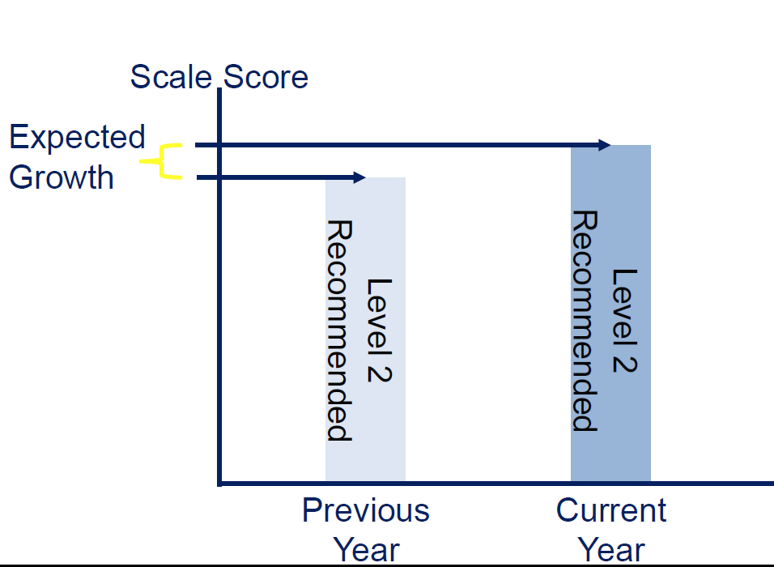
How is Growth Defined?

Slide 22
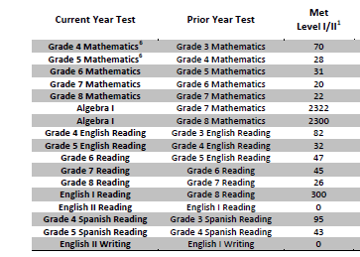
Progress Numbers

Slide 23
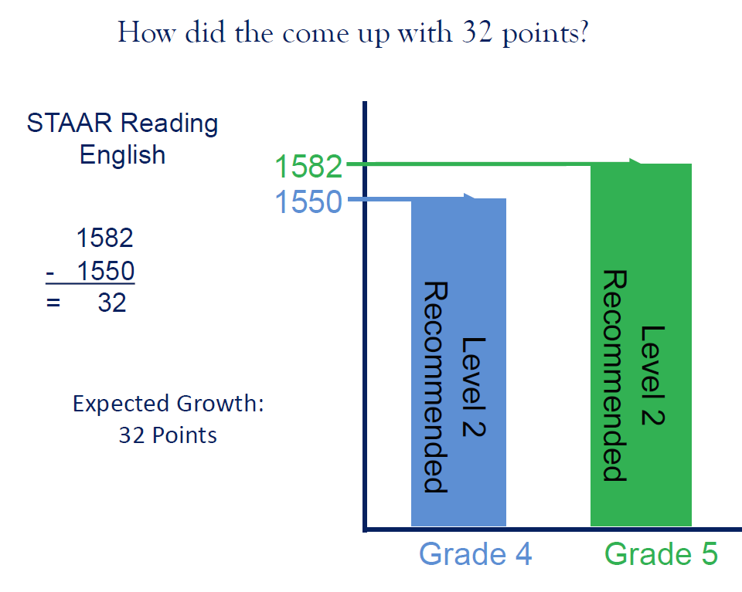

Slide 24
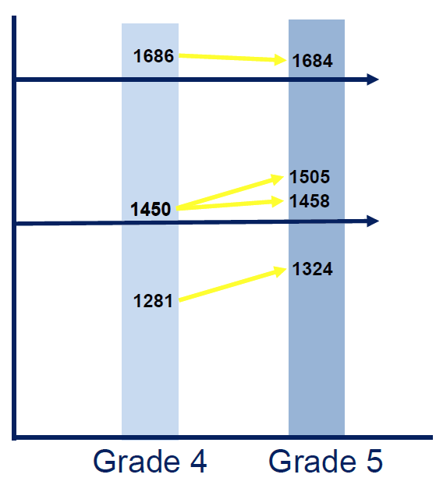
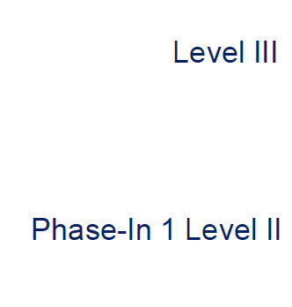
STAAR Grade 5 Reading Example

Slide 25
Index 2: Student Progress
2014 Target: 5th percentile based on campus type, district 5th percentile across all campus types
Index 2: 2013 Construction – Table 1
STAAR Weighted Progress Rate | All Students | African Amer. | Amer. Indian | Asian | Hispanic | Pacific Islander | White | Two or More Races | ELL | Special Ed. | Total Points | Max. Points
Example Calculation for Reading Progress Number of Tests | 100 | 50 |  | 40 |  |  |  |  | 30
Performance Results: Met or Exceeded Progress Number Percent | 80 80% | 40 80% |  | 40 100% |  |  |  |  | 20 67%
Exceeded Progress Number Percent | 20 20% | 20 40% |  | 30 75% |  |  |  |  | 5 17%
Reading Weighted Progress Rate | 100 | 120 |  | 175 |  |  |  |  | 84 |  | 479 | 800

Slide 26
Index 2: Student Progress
2014 Target: 5th percentile based on campus type, district 5th percentile across all campus types
Index 2: 2013 Construction – Table 2
STAAR Weighted Progress Rate | All Students | African Amer. | Amer. Indian | Asian | Hispanic | Pacific Islander | White | Two or More Races | ELL | Special Ed. | Total Points | Max. Points
Reading Weighted Progress | 100 | 120 |  | 175 |  |  |  |  | 84 |  | 479 | 800
Mathematics Weighted Progress | 85 | 98 |  | 150 |  |  |  |  | 160 |  | 493 | 800
Writing Weighted Progress | 140 | 170 |  |  |  |  |  |  |  |  | 310 | 400
Total |  |  |  |  |  |  |  |  |  |  | 1282 | 2000
Index 2 Score (total points divided by maximum points) |  |  |  |  |  |  |  |  |  |  | 64

Slide 27
Index 2 Accountability Tool
Index 2 - Student Progress |  | Groups >=25
Tests included: STAAR (Eng & Span), STAAR-M, STAAR-Alt, STAAR-L, & **ELL Progress (**See last tab on how to include ELL Progress for Index 2)
Indicator | All | African Amer | Amer. Indian | Asian | Hispanic | Pacific Islander | White | Two or More | **ELL | Special Ed. | Total Points | Max. Points
Elementary Campus Reading Number of Tests
# Did Not Meet Growth Expectation
# Met Growth Expectation
# Exceeded Growth Expectation
Percent of Tests: Met or Exceeded Expectation | 0% | 0% | 0% | 0% | 0% | 0% | 0% | 0% | 0% | 0%
Percent of Tests: Exceeded Expectation | 0% | 0% | 0% | 0% | 0% | 0% | 0% | 0% | 0% | 0%
Elementary Campus Reading Weighted Growth Rate | 0 | 0 | 0 | 0 | 0 | 0 | 0 | 0 | 0 | 0 | 0
 |  |  |  |  |  | Number of columns used is multiplied by 200 to fill in Max points

Slide 28

Index 3: Closing Performance Gaps
2014 Target: 5th percentile based on campus type, district 5th percentile across all campus types
Index 3: 2013 Construction – Table 1
Closing Performance Gaps emphasizes advanced academic achievement of the economically disadvantaged student group and the lowest performing race/ethnicity student groups at each campus and district.
By Subject Area: Reading, Mathematics, Writing, Science, and Social Studies Student
Student Groups:
  Economically Disadvantaged
  No minimum size
Two Lowest Performing Race/Ethnicity Groups
  Based on 2013 Index 1 All Subjects
  Minimum size: 25 tests in Reading and Math

Slide 29
Index 3: Closing Performance Gaps
Index 3: How to Determine Race/Ethnicity Groups for 2014 Index 3 Calculations

Slide 30
Index 3: Closing Performance Gaps
2014 Target: 5th percentile based on campus type, district 5th percentile across all campus types
Index 3: 2013 Construction – Table 1
Closing Performance Gaps emphasizes advanced academic achievement of the economically disadvantaged student group and the lowest performing race/ethnicity student groups at each campus and district.
English Language Learners (ELL) Included:
English STAAR Two – Four Years in U.S. Schools* included using ELL Progress Measure 1 point; Final Level II 2 points
English STAAR Five plus Years in U.S. Schools* included using Phase-in 1 Level II 1 point; Level III 2 points
Spanish STAAR Two plus Years in U.S. Schools* included using Phase-in 1 Level II 1 point; Level III 2 points
STAAR L included using ELL Progress Measure
English Language Learners (ELL) Exclusions:
English and Spanish STAAR English Language Learners (ELL) One year in U.S. Schools* excluded
*English Language Learners (ELL) Years in U.S. Schools as reported on 2014 TELPAS

Slide 31
Index 3: Closing Performance Gaps
2014 Target: 5th percentile based on campus type, district 5th percentile across all campus types
Index 3: 2013 Construction – Table 1
Closing Performance Gaps emphasizes advanced academic achievement of the economically disadvantaged student group and the lowest performing race/ethnicity student groups at each campus and district.
Points based on STAAR performance:
Phase-in 1 Level II satisfactory performance:
One point for each percentage of tests at Phase-in 1 Level II (Satisfactory)
Level III advanced performance:
Two points for each percentage of tests at the Level III Advanced

Slide 32
Index 3: Closing Performance Gaps
2014 Target: 5th percentile based on campus type, district 5th percentile across all campus types
Index 3: 2013 Construction – Table 1
STAAR Weighted Performance Rate | Economically Disadvantaged | Lowest Performing Race/Ethnic Group - 1 | Lowest Performing Race/Ethnic Group - 2 | Total Points | Maximum Points
Example Calculation for Reading Weighted Performance Number of Tests | 80 | 40 | 25
Performance Results: Phase-in 1 Level II Satisfactory and above Number Percent | 80 100% | 20 50% | 25 100%
Level III Advanced Number Percent | 40 50% | 0 0% | 25 100%
Reading Weighted Performance Rate | 150 | 50 | 200 | 400 | 600

Slide 33
Index 3: Closing Performance Gaps
2014 Target: 5th percentile based on campus type, district 5th percentile across all campus types
Index 3: Closing Performance Gaps emphasizes advanced academic achievement of economically disadvantaged students and the two lowest performing race/ethnicity student groups.
2013
Points based on STAAR performance:
  Phase-in 1 Level II satisfactory performance:
  One point for each percent of tests at the Phase-in 1 Level II satisfactory performance standard.
  By Subject Area:
  Reading, Mathematics, Writing, Science, and Social Studies.
  Student Groups:
  Economically Disadvantaged
  Lowest Performing Race/Ethnicity:
  The two lowest performing race/ethnicity student groups on the campus or within the district, based on 2012 assessment results.
2014
Points based on STAAR performance:
  Phase-in 1 Level II satisfactory performance:
  One point for each percent of tests at the Phase-in 1 Level II satisfactory performance standard.
  Level III advanced performance:
  Two points for each percent of tests at the Level III advanced performance standard.
  By Subject Area:
  Reading, Mathematics, Writing, Science, and Social Studies.
  Student Groups:
  Economically Disadvantaged
  Lowest Performing Race/Ethnicity:
  The two lowest performing race/ethnicity student groups on the campus or within the district, based on 2013 assessment results.
  Level III advanced performance:
  Two points for each percent of tests at the Level III advanced performance standard.
  Select the two lowest performing student groups if both the prior year reading and mathematics subject area test results each have at least 25 tests.
Shaded areas are new for 2014

Slide 34
Index 3: Closing Performance Gaps
2014 Target: 5th percentile based on campus type, district 5th percentile across all campus types
Index 3: 2013 Construction – Table 2
STAAR Weighted Performance Rate | Economically Disadvantaged | Lowest Performing Race/Ethnic Group - 1 | Lowest Performing Race/Ethnic Group - 2 | Total Points | Maximum Points
Reading Weighted Performance | 150 | 50 | 200 | 400 | 600
Mathematics Weighted Performance | 125 | 100 | 90 | 315 | 600
Writing Weighted Performance | 80 | 90 | 125 | 295 | 600
Science Weighted Performance | 120 | 40 | 90 | 250 | 600
Social Studies Weighted Performance | 50 | 40 | 80 | 170 | 600
Total |  |  |  | 1430 | 3000
Index 3 Score (total points divided by maximum points) |  |  |  | 48

Slide 35
Index 3 Accountability Tool
Index 3 - Closing Performance Gaps |  | Groups >=25
* It's possible you will not have two low performing race groups to report; must have had >= 25 in 2013 to count in 2014
Tests included: STAAR (Eng & Span), STAAR-M, STAAR-Alt, STAAR-L, & **ELL Progress (**See last tab on how to include ELL Progress for Index 3)
Indicator | Economically Disadvantaged | *Lowest Performing Race #1 | *Lowest Performing Race #2 | Total Points | Max. Points
Elementary Campus Reading Number of Tests |  |  | 0
Phase-in Level II # Satisfactory and above |  |  | 0
# Level III Advanced |  |  | 0
Percent of Tests: Phase-in Level II Satisfactory and above | #DIV/0! | #DIV/0! | 0%
Percent of Tests: Level III Advanced | #DIV/0! | #DIV/0! | 0%
Elementary Campus Reading Weighted Performance Rate | #DIV/0! | #DIV/0! | 0 | 0
 |  | Number of columns used is multiplied by 200 to fill in Max points

Slide 36
Index 4: Postsecondary Readiness
Index 4: Postsecondary Readiness emphasizes the importance of earning a high school diploma that provides students with the foundation necessary for success in college, the workforce, job training programs, or the military; and the role of elementary and middle schools in preparing students for high school.
2014 Index 4 non-AEA Targets:
Elementary Schools: 12
Middle Schools: 13
High Schools/K-12: 57 (based on all four components)*
Districts: 57 (based on all four components)*
*Non-AEA Targets If all four components : 1) STAAR Final Level II, 2) Graduation Score/Rate, 3) Graduation Plan, and 4) College-Ready Graduates are not available for high schools or districts, evaluate only the STAAR Final Level II performance at the following Index 4 targets:
High Schools/K-12: 21
Districts: 13

Slide 37
Index 4: Postsecondary Readiness
Index 4: Postsecondary Readiness emphasizes the importance of earning a high school diploma that provides students with the foundation necessary for success in college, the workforce, job training programs, or the military; and the role of elementary and middle schools in preparing students for high school.
STAAR Score: STAAR Percent Met Final Level ll on two or more tests for All Students and
race/ethnicity student groups Eight student groups:
All students
Seven race/ethnicity groups
All Subjects: Reading, Mathematics, Writing, Science and Social Studies
Students tested on one subject area only must meet the final Level II performance standard for that subject area.
Students tested on only two subject areas must meet the final Level II performance standard for both subject areas.

Slide 38
Index 4: Postsecondary Readiness
Index 4: Postsecondary Readiness emphasizes the importance of earning a high school diploma that provides students with the foundation necessary for success in college, the workforce, job training programs, or the military; and the role of elementary and middle schools in preparing students for high school.
STAAR Score: STAAR Percent Met Final Level ll on two or more tests for All Students and race/ethnicity student groups
Only include EOC tests for students that tested for the FIRST time in 2013-14 accountability cycle
  July 2013, Fall 2013 and Spring 2014
  Student EOC results for students that tested for the first time prior to the 2013-14 accountability cycle are not included in Index 4
Substitute Assessments for STAAR EOC tests are included

Slide 39
Index 4: Postsecondary Readiness
Index 4: Postsecondary Readiness emphasizes the importance of earning a high school diploma that provides students with the foundation necessary for success in college, the workforce, job training programs, or the military; and the role of elementary and middle schools in preparing students for high school.
Graduation Score/Rate: Combined performance across graduation/dropout rates for:
Grade 9-12 Class of 2013 Four-Year Graduation Rate OR
Grade 9-12 Class of 2012 Five-Year Graduation Rate
  whichever contributes the most points to the index
If a campus/district has no Graduation Rate, then the 2012-13 Grade 9-12 annual dropout rate will be used.
New campus – use annual dropout rate until they have enough years of data to calculate a longitudinal graduation rate
Ten student groups:
  All students
  Seven race/ethnicity groups
  Students with Disabilities
  English Language Learners (ELL)

Slide 40
Index 4: Postsecondary Readiness
Index 4: Postsecondary Readiness emphasizes the importance of earning a high school diploma that provides students with the foundation necessary for success in college, the workforce, job training programs, or the military; and the role of elementary and middle schools in preparing students for high school.
Graduation Plan Component
Class of 2013 Four-year Recommended High School Program/Distinguished Achievement Program (RHSP/DAP) Rate
Four-year Longitudinal Graduation Cohort
No four-year longitudinal graduation cohort – use annual percent of 2012-13 RHSP/DAP graduates

Slide 41

Index 4: Postsecondary Readiness
Index 4: Postsecondary Readiness emphasizes the importance of earning a high school diploma that provides students with the foundation necessary for success in college, the workforce, job training programs, or the military; and the role of elementary and middle schools in preparing students for high school.
College-Ready Graduates: High school graduates from the 2012-13
school year who met the college-ready criteria in both ELA and mathematics based on:
TAKS exit-level test*,
or the SAT test,
or the ACT test
  Reported on AEIS and TAPR since 2007
  *2012-13 graduates are TAKS graduates

Slide 42
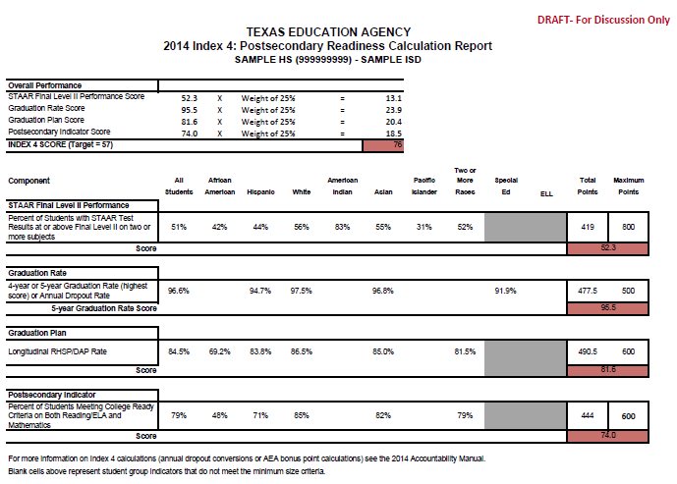

Slide 43
Index 4: Postsecondary Readiness
Index 4: 2013 vs. 2014 Comparison
2013
Graduation Score: Combined performance across the graduation and dropout rates for:
Grade 9-12 Four-Year Graduation Rate for All Students and all student groups; or
Grade 9-12 Five-Year Graduation Rate for All Students and all student groups, whichever contributes the higher number of points to the index.
RHSP/DAP Annual Graduates: All Students and race/ethnicity student groups.
2014
Graduation Score: Combined performance across the graduation and dropout rates for:
Grade 9-12 Four-Year Graduation Rate for All Students and all student groups; or
Grade 9-12 Five-Year Graduation Rate for All Students and all student groups, whichever contributes the higher number of points to the index.
RHSP/DAP Graduates : All Students and race/ethnicity student groups.
STAAR Score: STAAR Percent Met Final Level ll on one or more tests for All Students and race/ethnicity student groups.
Additional Indicators Required by House Bill 5 (83rd Texas Legislature, 2013)
Texas Success Initiative college readiness benchmarks.
Number of students who earn postsecondary credit required for a foundation high school program, an associate’s degree, or an industry certification.
STAAR Score: STAAR Percent Met Final Level ll on TWO or more tests for All Students and race/ethnicity student groups.
Additional Indicators Required by House Bill 5 (83rd Texas Legislature, 2013)
Texas Success Initiative college readiness benchmarks.
Number of students who earn postsecondary credit required for a foundation high school program, an associate’s degree, or an industry certification.
Shaded areas are new for 2014

Slide 44
Index 4: Postsecondary Readiness
Index 4: AEA Campuses and Charters
2013
Proposed 2014
4-, 5-, and 6-year Graduation and General Education Development (GED) Score;
If no Graduation and GED Rates, use Grade 9-12 Annual Dropout Rate: Points given for annual dropout rates lower than 20.0
2013 AEA Registration Criterion
4-, 5-, and 6-year Graduation, Continuing Students, and GED Score;
If no Graduation, Continuing, and GED Rates, use Grade 9-12 Annual Dropout Rate: Points given for rates lower than 20.0
STAAR Score: STAAR Percent Met Final Level ll on one or more tests
Contrib. to Points
75%
25%
Continuing Students,
STAAR Score: STAAR Percent Met Final Level ll on one or more tests
Expand AEA Registration to include Dropout Recovery centers
Expand AEA Registration to include dropout recovery schools
Shaded areas are new for 2014

Slide 45
Index 4: Postsecondary Readiness
Index 4: AEA Campuses and Charters Bonus Points
2013
Proposed 2014
Bonus Points:
  RHSP/DAP Rate: All Students.
  Continuing Students Success Rate: All Students.
  Excluded Students Count: All Students.
Bonus Points:
  RHSP/DAP Rate: All Students.
  Excluded Students Count: All Students.
  Postsecondary/College-Ready Graduates Indicator
Shaded areas are new for 2014

Slide 46
Index 4: Postsecondary Readiness
Indicator | All Students | African Amer. | Amer. Indian | Asian | Hispanic | Pacific Islander | White | Two or More Races | ELL | Special Ed. | Total Points | Max. Points
STAAR Score
STAAR % Met Final Level ll on Two or More Tests | 29% | 16% |  | 40% | 23% |  | 38% | 36% |  |  | 182 | 600
STAAR Score (STAAR total points divided by maximum points) |  |  |  |  |  |  |  |  |  |  | 30
Graduation Score (Gr. 9-12)
4-yr. graduation rate | 84.3% | 78.8% |  |  | 78.8% |  | 91.6% | 86.0% | 44.2% | 69.8% | 533.5 | 700
5-yr. graduation rate | 85.1% | 78.8% |  |  | 80.0% |  | 92.1% | 84.0% | 48.9% | 77.5% | 546.4 | 700
Highest Graduation Total |  |  |  |  |  |  |  |  |  |  | 546.4 | 700
Graduation Score (best of total graduation points divided by maximum points) |  |  |  |  |  |  |  |  |  |  | 78.0
RHSP/DAP Score
4-yr. graduation Percent RHSP/DAP | 82.7% | 76.4% |  |  | 83.6% |  | 83.0% |  |  |  | 325.7 | 400
RHSP/DAP Score (best of total RHSP/DAP points divided by maximum points) |  |  |  |  |  |  |  |  |  |  | 81.4
Postsecondary/College-Ready Graduates Score
College-Ready Graduates either subject (ELA or Math) | 82.0% | 72.0% |  |  | 78.0% |  | 89.0% |  |  |  | 321.0 | 400
College-Ready Score (total points divided by maximum points) |  |  |  |  |  |  |  |  |  |  | 80.2
Overall Index Score
STAAR Score | 30.0 | Multiply by Weight
Graduation Score | 78.0
RHSP/DAP Score | 81.4
College-Ready Score | 80.2
Index Score (sum of weighted index scores)

Slide 47
Index 4 Accountability Tool
Index 4 - Postsecondary Readiness
Indicator Elementary School Campus | All | African Amer | Amer. Indian | Asian | Hispanic | Pacific Islander | White | Two or More | ELL | Special Ed. | Total Points | Max. Points
STAAR Score |  |  |  |  |  |  |  | Number of columns used is multiplied by 100 to fill in Max points
STAAR % Met Final Level II on Two or More Tests |  |  |  |  |  |  |  |  |  |  | 0
Elementary STAAR Score |  |  |  |  |  |  |  |  |  |  |  | #DIV/0!
Index 4 - Postsecondary Readiness
Indicator Junior High School Campus | All | African Amer | Amer. Indian | Asian | Hispanic | Pacific Islander | White | Two or More | ELL | Special Ed. | Total Points | Max. Points
STAAR Score |  |  |  |  |  |  |  | Number of columns used is multiplied by 100 to fill in Max points
STAAR % Met Final Level II on Two or More Tests |  |  |  |  |  |  |  |  |  |  | 0
Junior High STAAR Score |  |  |  |  |  |  |  |  |  |  |  | #DIV/0!

Slide 48
System Safeguards
Safeguard Measures and Targets for the State lens:
Reporting system disaggregates performance by student group, performance level, and subject area.
Performance rates are calculated from the assessment results used to calculate Index 1: Student Achievement.
2014 targets for the disaggregated system-safeguard results:
  STAAR performance target corresponds to Index 1 (55%);
  STAAR participation target required by federal accountability (95%);
Federal graduation rate targets and improvement calculations for 4-year rate (80%) and 5-year rate (85%); and
➢ Federal limit on use of alternate assessments (1% and 2%)

Slide 49
System Safeguards
2014 targets for federal accountability:
STAAR performance target corresponds to Index 1 (79%);
  All Students, African American, Hispanic, White, Economically Disadvantaged, Special Education and English Language Learner
  English Language Learners(ELL) now includes Current and Monitored ELLs
STAAR participation target required by federal accountability (95%);
Federal graduation rate targets and improvement calculations for 4-year rate (80%) and 5-year rate (85%); and
Federal limit on use of alternate assessments (1% and 2%)

Slide 51
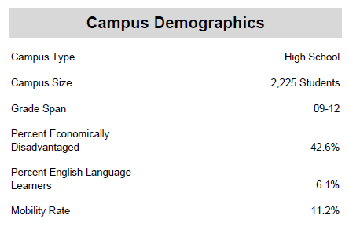
2014 Distinction Designations
Per Texas Education Code (TEC) §39.201, alternative education campuses (AECs) evaluated under AEA provisions are not eligible for distinction designations.
Comparison Groups are determined by common campus
Demographics.

Slide 52
2014 Distinction Designations
Student Progress (based on Index 2)
Closing Performance Gaps (based on Index 3)
Academic Achievement in:
  Reading/English Language Arts
  Mathematics
  Science
  Social Studies
Postsecondary Readiness for campuses and districts

Slide 53
2014 Distinction Designations
Districts and Campuses Postsecondary Readiness:
House Bill 5 (83rd Texas Legislature, 2013) expanded distinction designations to both districts and campuses for outstanding performance in attainment of postsecondary readiness.
Index 4 STAAR Component: Percent of Students at Final Level II Performance Standard
Four-Year Graduation Rate (Class of 2013 longitudinal cohort) Recommended High School Program or
Distinguished Achievement Program (RHSP/DAP) Rates (Class of 2013 longitudinal cohort)
College-Ready Graduates (school year 2012-13 graduates meeting the Texas Success Initiative (TSI) college readiness standards in both reading/ELA and mathematics based on TAKS, SAT, or ACT)
Advanced/Dual Enrollment Course Completion Rate (school year 2012-13)
SAT/ACT Performance (At/Above Criterion, 2012-13)
SAT/ACT Participation (2012-13)
AP/IB Examination Performance: Any Subject (school year 2012-13percent of examinees meeting the criterion score)

Slide 54

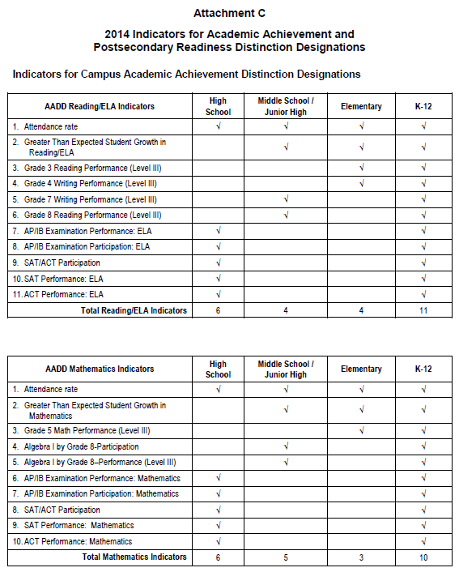
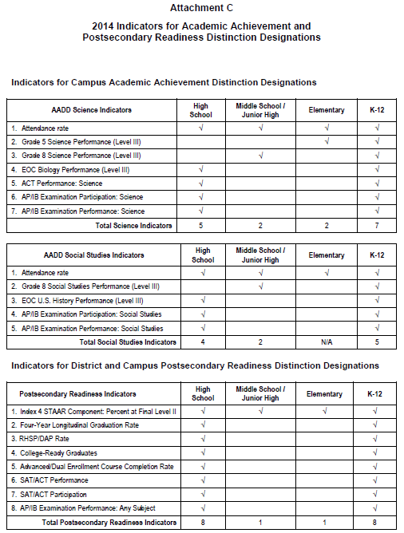

Slide 55

Resources
2014 Accountability Development
http://ritter.tea.state.tx.us/perfreport/account/2014/index.html
2013 Accountability Rating System
http://ritter.tea.state.tx.us/perfreport/account/2013/index.html
Performance Reporting Home Page
http://www.tea.state.tx.us/perfreport
Performance Reporting E-mail
performance.reporting@tea.state.tx.us
Thank you to Cheri Hendrick of Region 20 for her help!!!

